Slide 1
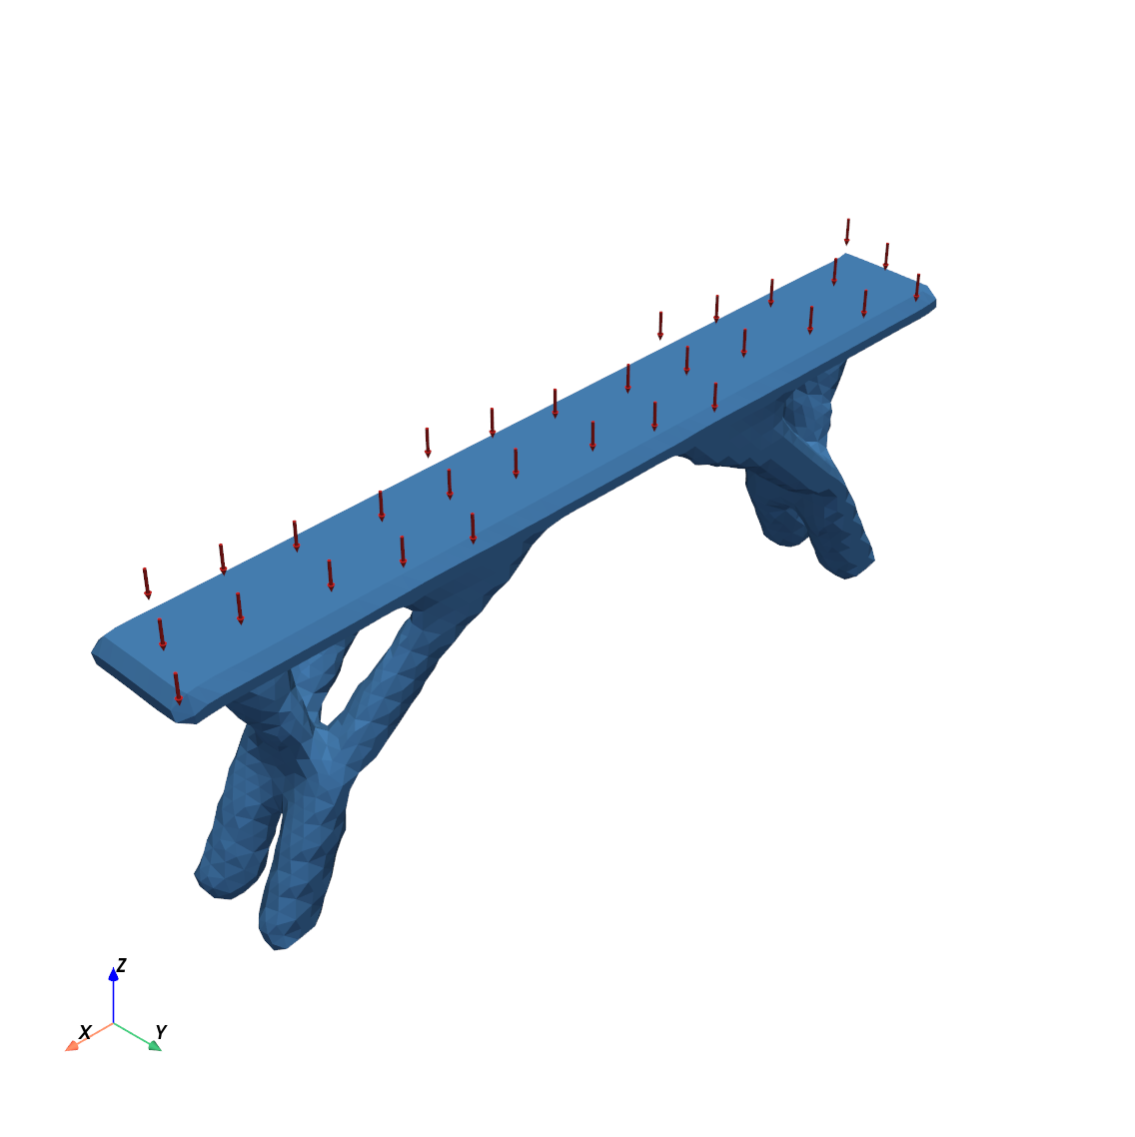
3D topology optimization with AI
MECH 4208/5208 · COMPUTATIONAL DESIGN · PROJECT 3
From my 2D Project 2 code to a desktop app that designs a pedestrian bridge
[Your name] · [Presentation date]
Notes:
Project 3 asked us to extend our 2D topology optimization code to 3D with a user interface, using AI step by step. I will show how I worked with the AI, what changed in the core code, my civil model (a pedestrian bridge), and a live demo of the app. The picture is the final optimized bridge exported from the app.

Slide 2
Five steps, from simple to complex
THE ASSIGNMENT
1
2
3
4
5
3D cantilever
Architecture
Any shape
User interface
Post-process
Extend my 2D code with Hex8 elements and test it
Core FEA and optimization code separate from the GUI
STL file → voxels; each voxel is one Hex8 element
Import, voxelize, add supports and loads, run
Threshold, smooth and export the result as STL
Deliverable: this presentation — my AI workflow, a live demo of the app, and what changed in the core code from 2D to 3D.
Project 3 · 3D topology optimization with AI
2
Notes:
The professor did not give a final target. The idea was to use AI as a process: start with a standard 3D problem, then add architecture, general shapes, an interface and post-processing. I followed exactly these five steps, testing each one before the next.

Slide 3

How I worked with the AI
AI WORKFLOW
I ask
AI plans
AI codes
Tests run
I review
One step at a time, in my own words
Says what it will build and test before coding
Works directly in my course folder
Automatic checks and real-window GUI tests
Question, decide, and log it in my notes
44
2
23
automatic tests of the core and the GUI logic
self-tests that drive the real app window
errors logged, each with its cause and fix
Tool: Claude in the Claude Code desktop app · every prompt, decision and error is in AI_workflow_notes.md
Project 3 · 3D topology optimization with AI
3
Notes:
I never asked for the whole app at once. Each step started with my own question. The AI first said what it would build and how it would test it, then wrote the code in my folder and ran the tests. I reviewed the results and asked questions, for example about Poisson’s ratio, the filter radius and the Jacobian. Every prompt, decision and error is logged in my notes file.

Slide 4
What changed from 2D (Q4) to 3D (Hex8)
STEP 1 · CORE CODE
Item | 2D · Project 2 | 3D · Project 3
Element | Q4, 4 nodes | Hex8, 8 nodes
DOFs per node | 2 | 3
Element stiffness | 8 × 8 | 24 × 24
B and D matrices | 3 × 8, 3 × 3 plane stress | 6 × 24, 6 × 6 3D elasticity
Gauss points | 2 × 2 | 2 × 2 × 2
Jacobian | cancels for squares (left out) | must be kept: kₑ grows with size
Global K and solver | dense, np.linalg.solve | sparse; direct or CG solver
Filter neighbours | all pairs, circle | KD-tree, sphere, sparse
Unchanged | SIMP, sensitivity, OC update | same equations
Project 3 · 3D topology optimization with AI
4
Notes:
This is the core code comparison the assignment asks for. The method is the same as Project 2: SIMP penalty, sensitivity filter and optimality criteria. What changes is the element: 8 nodes, 3 DOFs each, so a 24 by 24 element matrix. One question I asked the AI: do we need the Jacobian? In 2D the size factors cancel for square elements, (2/a)² times (a/2)² equals 1. In 3D one size factor is left over, a/2, so it must stay. Big 3D models also need a sparse matrix and a sparse solver.

Slide 5
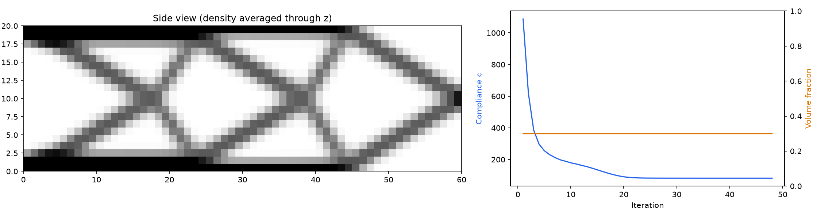
Four tests before trusting the optimizer
STEP 1 · VERIFICATION
1 · Element
2 · Beam theory
3 · Project 2
4 · 3D cantilever
24 × 24, symmetric, exactly 6 rigid-body modes (2D: 3)
Tip deflection 95.7 → 99.5 → 100.4 % of Timoshenko as the mesh is refined
A one-element-thick slab reproduces my 2D shape
60 × 20 × 4 elements, 19,215 DOFs, converged in 48 iterations
Test 4: the top and bottom flanges use the full thickness, the diagonals only part of it (gray in the average) — an I-beam that a 2D model cannot find.
Project 3 · 3D topology optimization with AI
5
Notes:
We tested from small to big. The element matrix must have six zero eigenvalues, the rigid-body modes. The solid beam must approach beam theory when the mesh is refined, and it does: 95.7, 99.5, 100.4 percent. Then the 3D code must give my 2D result for a one-element-thick slab. Only then did we trust the true 3D cantilever. Its side view shows a real 3D effect: thick flanges and a thinner web.

Slide 6
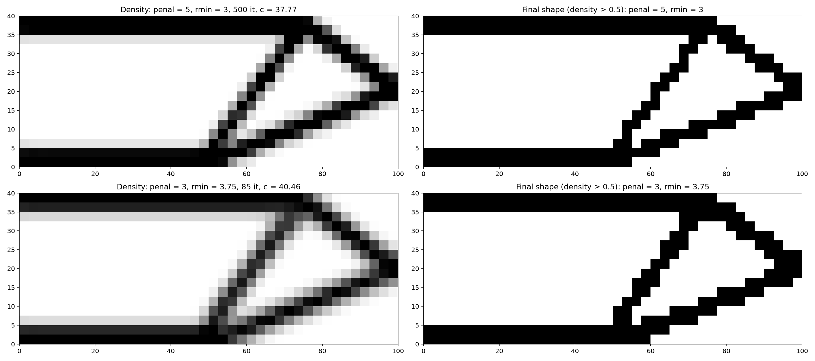
The 3D tests exposed a hidden support in my 2D code
FINDING WHILE TESTING
My 2D solve_FE (from the class template) fixes:
x only on the left edge (rollers)
y at node 21, which in this mesh is (50, 0): the middle of the bottom edge
That extra pin is why the bottom bar stops near x = 50, in my result and in the course example.
Also found: penal 5 with rmin 3 (only 1.2 elements) never converges — the design cycles between 4 almost equal shapes.
3D slab with the same supports gives my 2D shape (left: density, right: density ≥ 0.5).
Project 3 · 3D topology optimization with AI
6
Notes:
At first the 3D slab gave a symmetric truss, but my 2D result is asymmetric. The AI solved my own 2D model at full density and found that the vertical displacement at (50, 0) was exactly zero. The line fixed_dof = fixed_node*2-2 plus [[21*2-1]] from the template pins that node. With the same supports, the 3D code gives exactly my 2D shape. I did not change Project 2; this is only a finding. The second finding explains why my 2D run always hit 100 iterations.

Slide 7

A core that knows nothing about the GUI
STEP 2 · ARCHITECTURE
GUI · gui/
Notebooks
Progress through a callback
PySide6 + PyVista: pick faces, draw, run in a worker thread
Step 1–5 studies, plots from plotting.py
After every iteration the optimizer calls callback(info). The notebook prints it; the GUI redraws the 3D view, and Stop simply returns False.
call only the core’s functions
Core · topopt3d/ — numbers in, numbers out
A measured choice
mesh.py
boundary.py
fea.py
filters.py
Bracket, 22,680 DOFs: CG solver 0.84 s vs direct 5.45 s per iteration — 6.5× faster, same result.
optimizer.py
stl_io.py
voxelize.py
postprocess
tests/ — 44 automatic checks: element, beam theory, STL, smoothing, GUI logic
Project 3 · 3D topology optimization with AI
7
Notes:
The professor asked that the GUI be decoupled from the core so the core can be checked on its own. The core package never plots and never imports Qt. The GUI and the notebooks only call its functions: build a mesh, define supports and loads, choose settings, run. The key idea is the callback: the same optimizer prints in a notebook and redraws in the GUI. The solver choice was measured, not guessed: the CG solver is 6.5 times faster on large models.

Slide 8
From an STL file to a voxel model
STEP 3 · ANY SHAPE
Ray casting, written in numpy
Check: voxel volume vs STL volume
1
Shoot a ray along z through the centre of every column of voxels.
Part | Resolution | Volume error
Box | 10 | 0.00 % (exact)
Sphere | 10 / 20 / 40 | +5.6 / +1.0 / +0.3 %
Bracket | 20 / 40 / 80 | −1.3 / +0.9 / −0.1 %
Bridge | 30 / 60 | −4.8 / 0.00 %
2
Each crossing of a surface triangle switches between outside and inside.
3
A voxel is inside when an odd number of crossings lies below it. An odd total in a column means the STL has a gap: the app warns.
Each voxel becomes one Hex8 element. All voxels are identical, so one 24 × 24 kₑ serves the whole model.
The error shrinks as voxels get smaller. Voxelizing takes under 0.2 s, even for 22,768 triangles.
Project 3 · 3D topology optimization with AI
8
Notes:
To use any shape, the STL surface is turned into voxels. The AI wrote its own ray-casting voxelizer instead of using a black-box library, so I can explain it. Rays are shifted by a tiny amount so they never hit a triangle edge exactly. We checked it on parts with a known volume: the box is exact, and the sphere and bracket errors shrink with resolution. For the bridge, resolution 60 gives voxels of size 2, which fit its dimensions exactly.

Slide 9
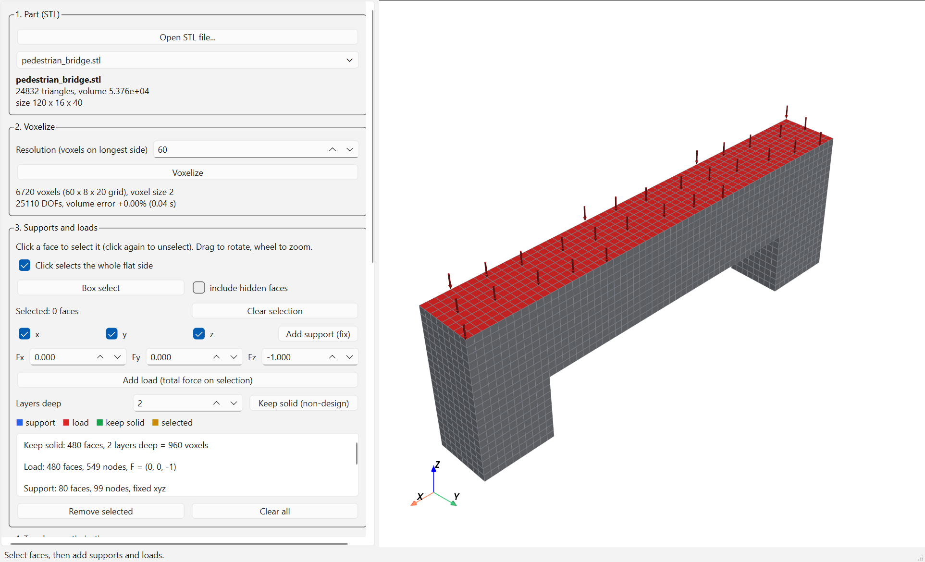
A pedestrian bridge over a clearance opening
MY CIVIL MODEL
Item | Value
Design domain | 120 × 16 × 40 (z up)
Opening | 80 × 18, no material
Abutments | 20 long, base supported
Deck | top 4 units kept solid
Load | uniform on deck, total 1 ↓
Material | E = 1, ν = 0.25
Settings | volfrac 0.30, p = 3, rmin 1.5
Mesh | 6,720 voxels, 25,110 DOFs
Set up in my app: deck kept solid and loaded, both abutment bases supported.
Project 3 · 3D topology optimization with AI
9
Notes:
I am from the civil department, so I chose a civil model instead of a mechanical bracket. The challenge is in the modelling: a distributed pedestrian load, realistic supports, and a deck that must stay solid. For the deck, we added a new feature to the core: keep regions, elements that always stay solid and count in the volume. I ran two support cases: both abutments pinned, and one pinned, one on a roller.

Slide 10
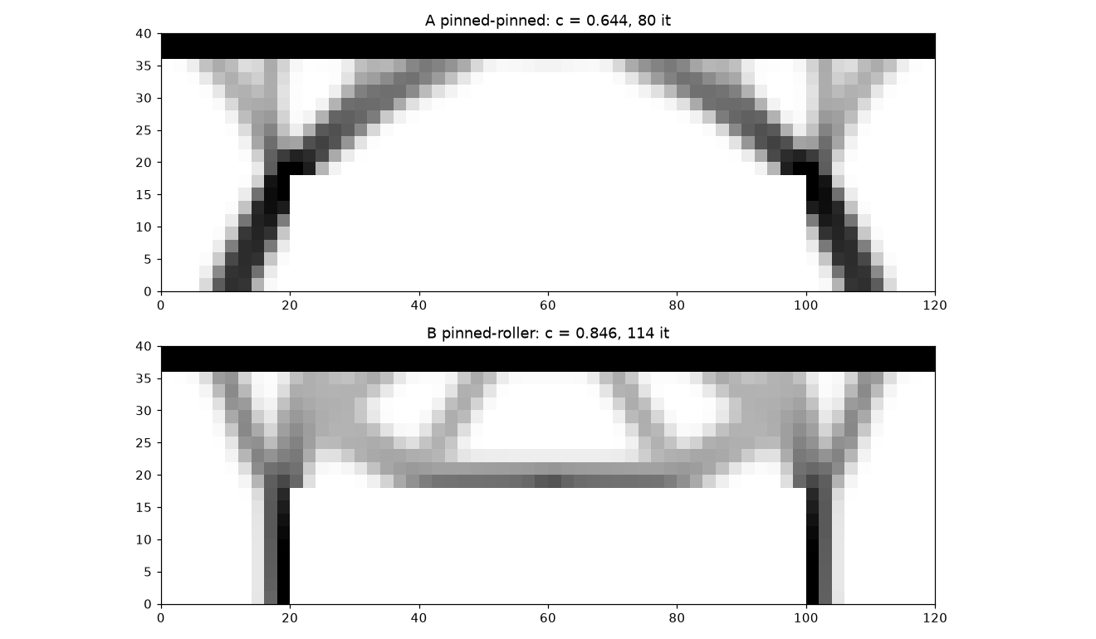
The supports decide the structural system
RESULT
A · pinned – pinned
Inclined legs push out on the abutments (arch-like). Thrust Rx = ±0.234, compliance 0.644.
B · pinned – roller
No horizontal reaction (Rx = 0), so vertical legs and a tie appear. Compliance 0.846.
Same material: B is 31 % more flexible.
Check: vertical reactions 0.5 + 0.5 = the load.
Project 3 · 3D topology optimization with AI
10
Notes:
Top is case A, bottom is case B. With both abutments pinned, the optimizer makes inclined legs that push outward like an arch, and the abutments resist that thrust: 0.234, about 47 percent of the vertical reaction. With a roller there can be no horizontal reaction, so the legs become vertical and a tie appears across the opening; the structure carries the thrust itself. The optimizer rediscovered basic structural behaviour from the supports alone.

Slide 11
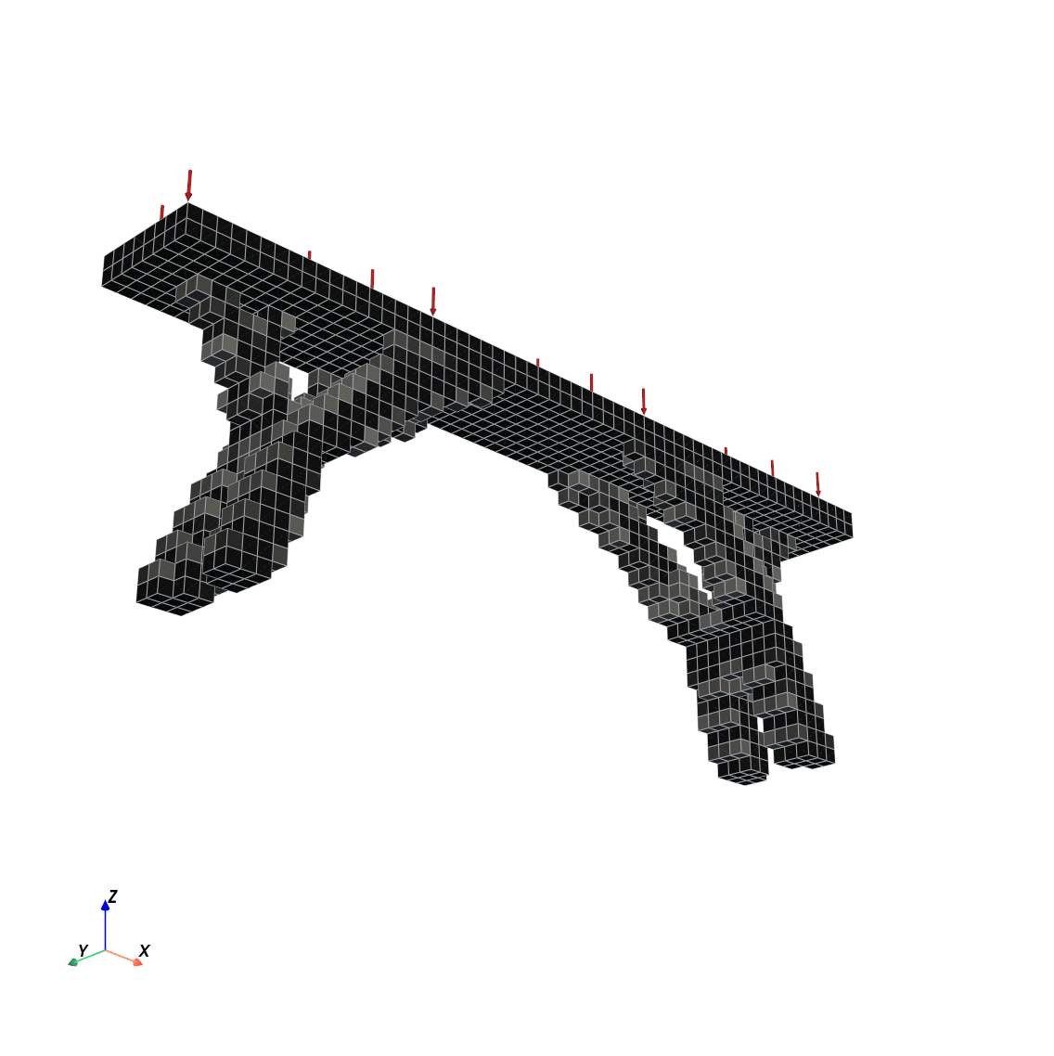
Supports and loads: click, box-select, keep solid
STEP 4 · THE APP
Click a face: the whole flat side is selected. Dragging still rotates the view.
Box select: drag a rectangle, for curved regions such as a bolt hole.
Add support: fix x, y and/or z. A roller is “uncheck x”.
Add load: a total force (Fx, Fy, Fz) spread over the selected nodes.
Keep solid: the voxels under the faces, N layers deep — the bridge deck.
The optimization runs in the background with a live 3D view and a Stop button. A self-test drives the real window: same result as the notebook, 80 iterations, c = 0.6442.
Project 3 · 3D topology optimization with AI
11
Notes:
The professor said one decision we must make is how to add boundary conditions. My choice: click faces plus box selection. The outer faces of the voxel model are clickable; one click can select a whole flat side. Supports fix chosen directions, loads spread a total force, and keep-solid protects the deck. I could not click the app myself during development, so the AI wrote a self-test that drives the real window, including real clicks, and it reproduces the notebook exactly. The picture shows the result from below: two forked legs at each abutment.

Slide 12

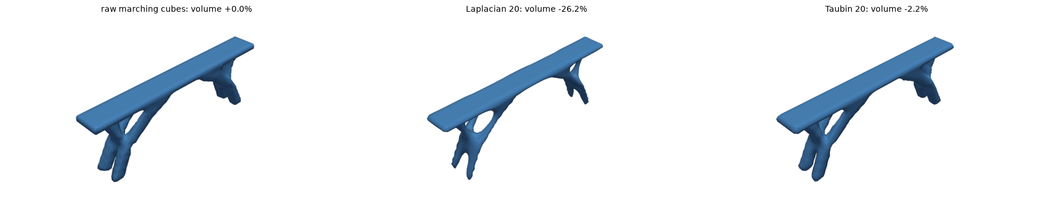
Taubin smoothing keeps the shape; Laplacian shrinks it
STEP 5 · POST-PROCESSING
Threshold ≥ 0.5
Remove islands
Marching cubes
Taubin smoothing
STL
−26 %
−2.2 %
Blur off
volume with Laplacian: thin legs collapse
volume with Taubin: smooth, same shape
a pre-blur thinned 2-voxel members
Project 3 · 3D topology optimization with AI
12
Notes:
The assignment let us decide how to smooth the result with the help of AI. We measured three options instead of guessing. Laplacian smoothing moves each vertex to the average of its neighbours: smooth, but the part shrinks; on the bridge it lost 26 percent of its volume. Taubin smoothing alternates a smoothing step and a slightly bigger un-shrinking step, so it keeps the shape. A light blur before marching cubes made thin members thinner, so it is off by default.

Slide 13
Smoothing rounded off the supports
FINDING WHILE CHECKING THE EXPORT
The exported bridge B came out 38× too flexible — a number that could not be right. The cause: rounded feet that barely touched the ground.
Exported STL | Free smoothing | Outer faces flat
Lowest point (ground = 0) | −1.06 | 0.00
Ground contact nodes, A / B | 10 / 4 | 29–30 / 22
More flexible than voxel design, A | +35 % | +5.3 %
More flexible than voxel design, B | +3,683 % (mechanism) | +2.4 %
Fix in the core: vertices on the 6 outer planes of the design domain may slide along the plane but not leave it. On by default, with a checkbox in the app.
Project 3 · 3D topology optimization with AI
13
Notes:
This is my favourite finding. To check the exported part, we voxelized the STL again and analysed it with the same supports and load. Bridge B was 38 times too flexible. The first guess about the cause was wrong. Printing the support nodes showed the truth: smoothing had rounded the feet, so they touched the ground at only 4 nodes, and they even bulged below the ground. On a roller that is almost a mechanism. The fix keeps outer faces flat; now the exported parts are within 2 to 5 percent of the voxel design. Lesson: always check the final product, not only the optimizer.

Slide 14
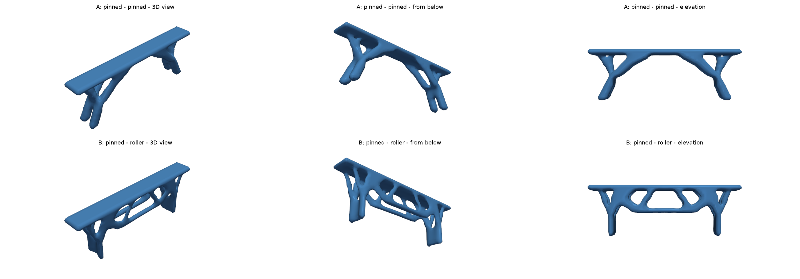
Two exported bridges, ready as closed STL files
FINAL PARTS
A uses 27.1 % and B 25.1 % of the design domain · 0 open edges · exported B is 37 % more flexible than A (optimizer: 31 %), so the civil conclusion survives post-processing.
Project 3 · 3D topology optimization with AI
14
Notes:
These are the final exported files, bridge A on top and bridge B below, each in a 3D view, from below and in elevation. Both are closed surfaces that a slicer or CAD program can open. The difference between the two support cases is still there after smoothing and export.

Slide 15
What went wrong, and how it was caught
AI WORKFLOW · LESSONS
Problem | Cause | Caught by
Hidden pin in my 2D code | template fixes node 21 in y | 3D slab vs my 2D result
ν = 0.3 in some tests, 0.25 in others | a default value the AI chose | my question
Exported bridge 38× too flexible | smoothing rounded the feet | structural check of the STL
5.45 s per iteration on the bracket | direct solver fill-in in 3D | benchmark → CG, 6.5× faster
STL normals pointing inward | marching-cubes triangle order | test: volume must be positive
Load divided over zero nodes | no node at mid-height (odd mesh) | the beam test crashed
Three failing new tests | the test’s expectation was wrong | reading the failure first
Test each step against something known
Question the AI’s inputs and defaults
Tests can be wrong too
Check the final product, not only the optimizer
Project 3 · 3D topology optimization with AI
15
Notes:
The assignment asks which errors we met. My notes list 23; these are the most instructive. Some were caught by tests, some by benchmarks, and some only because I asked a question, for example about Poisson’s ratio. Three times a new test failed and the code was right: the test’s expectation was wrong. My four lessons are at the bottom.

Slide 16
Optimizing the bridge in the app
LIVE DEMO
1
Choose pedestrian_bridge.stl → resolution 60 → Voxelize
If time is short
2
Click the deck → Layers deep 2 → Keep solid
Start: double-click Run_TopOpt3D_App.bat
3
Click the deck again → Fz = −1 → Add load
Resolution 40 runs faster than 60 (case A at 60: about 70 s)
4
Rotate, click each abutment base → Add support (roller: uncheck x)
5
Run: volume 0.30, penalty 3, rmin 1.5 — watch it converge
Backup: python -m gui --selftest bridge replays the whole session in about 2 minutes
6
Density threshold → Preview smooth surface → Export STL
Project 3 · 3D topology optimization with AI
16
Notes:
Switch to the app here. Follow the six steps on the slide. While it runs, point out the live 3D view and the convergence plot. If something goes wrong, run the self-test, which replays the same session and checks the result against the notebook.

Slide 17
Limits and next steps
HONEST LIMITS
Limits of this model
Next steps
One load case: no unbalanced pedestrian or wind load
No self-weight
Linear, isotropic material: steel-like; concrete’s weak tension is not modelled
Voxel size limits thin members and curved faces
Several load cases, for example half-span pedestrian load
Self-weight and stress constraints
The GE jet engine bracket benchmark
Finer voxels with a faster solver (multigrid)
Project 3 · 3D topology optimization with AI
17
Notes:
A real bridge needs more than one load case. A half-span pedestrian load would make the design less symmetric. Self-weight matters a lot for bridges, and concrete would need a different material model. These are the next steps, together with the GE bracket as a mechanical benchmark.

Slide 18
Thank you
Questions?
In my project folder: AI_workflow_notes.md (every prompt, decision and error) · ARCHITECTURE.md · Step 1–5 notebooks · the app: Run_TopOpt3D_App.bat
[Your name] · [Email or course section]
Notes:
Thank you. I am happy to answer questions about the code, the AI workflow, or the bridge results.

